Slide 1
FAKE NEWS DETECTION
AI mini project -
Alankrit sahai(RA1911026010103)
Sai praveen sura(RA1911026010104)

Slide 2
ABSTRACT
Intentionally deceptive content presented under the guise of legitimate journalism is a worldwide information accuracy and integrity problem that affects opinion forming, decision making, and voting patterns. Most so-called 'fake news' is initially distributed over social media conduits like Facebook and Twitter and later finds its way into mainstream media platforms such as traditional television and radio news. The fake news stories that are initially seeded over social media platforms share key linguistic characteristics such as making excessive use of unsubstantiated hyperbole and non-attributed quoted content.
In this project, the results of a fake news identification study that documents the performance of a fake news classifier are presented.

Slide 3
ISSUES IN EXISTING MODEL
Accuracy of the existing system wasn’t that good our project proposes a solution with better accuracy
Availability of systematic solution wasn’t there in public.

Slide 4
PROBLEM STATEMENT
Mass media sources, specifically the news media, have traditionally informed us of daily events
In recent years, the reliability of information on the internet has emerged as a crucial issue of modern society.
The proliferation of fake news on social media and internet is deceiving people to extent which needs to be stopped

Slide 5
OBJECTIVE
Our goal is to develop a reliable model that classifies a given news article as either fake or true when it is trained with a certain dataset.

Slide 6
PROPOSED METHODOLOGY
NLP(NATURAL LANGUAGE PROCESSING)
Natural language processing (NLP) refers to the branch of computer science—and more specifically, the branch of artificial intelligence or AI—concerned with giving computers the ability to understand text and spoken words in much the same way human beings can.
1)TOKENIZATION
2)STEMMING
3)STOP-WORD REMOVAL

Slide 7
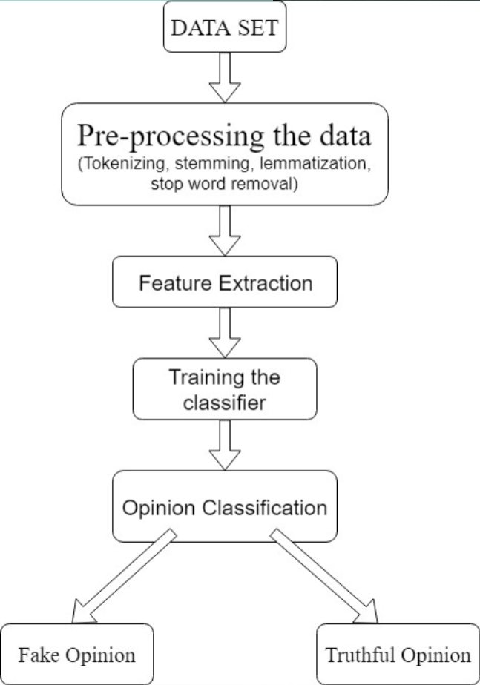

Slide 8
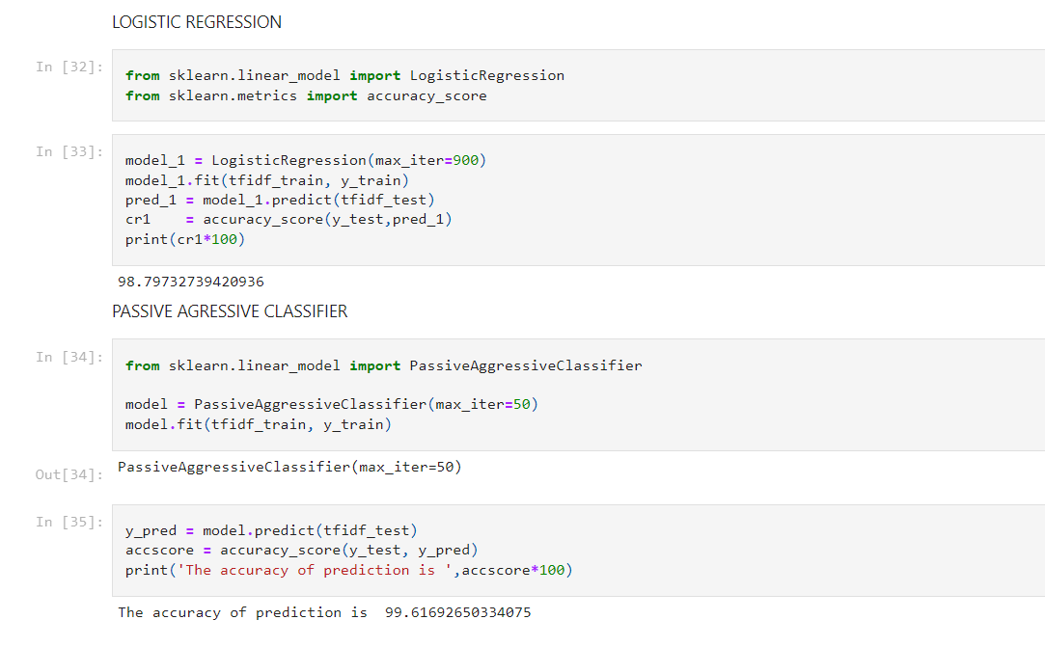
DEMO

Slide 9
PROOF OF GITHUB UPLOAD

Slide 10
PURPOSE OF PROBLEM STATEMENT
The growing problem of fake news only makes things more complicated and tries to change or hamper the opinion and attitude of people towards use of digital technology.
Our system takes input from existing database and classify it to be true or fake, so the people can understand whether the respective news is true of fake.

